Slide 1

Test Automation
TFS ALM using Selenium and SpecFlow

Slide 2
Test Automation
Why
Test Automation can;
Improves Accuracy - Automated tests perform the same steps precisely every time they are executed.
Increase Test Coverage – Easily create test scenarios by copy and pasting existing tests and changing input and output parameters and allowing manual testers to focus on more exploratory tests
Scalable Load – Tests can be run against multiple environment concurrently and over a long duration to test environment robustness and product performance
Assist During Development – Tests can be run as a continuous integration process ensuring code being released is of a high testable quality.

Slide 3
CPA Test Automation
Planit’s Solution
The project is stored within TFS. It is build and deployed the same way other applications in TFS are.
Planit Framework
Visual C# Unit Test Project
Selenium Library
Test Class -Test Method1 - Test Method2…
Property Settings - Brower Type - TestEnvironment - WaitTimes
Page Model - CustomerIDText - PasswordTest - ClickLoginButton
SpecFlow Feature -Test Scenario1 - Test Scenario2…
SpecFlow Steps -Step Method1 - Step Method2…
Common Class - GET Method - SET Method - CLICK Method

Slide 4
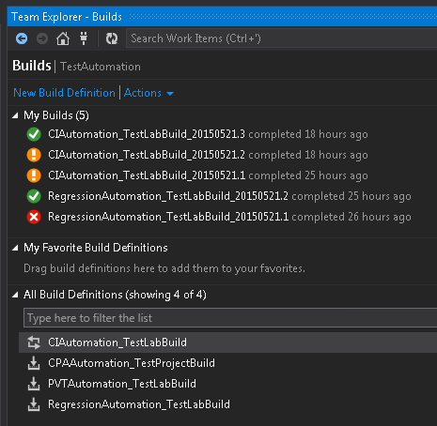
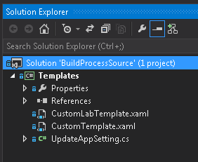
CPA Test Automation
Planit’s Solution
Custom Build Definitions have been created to run the CI process. A Custom Code Activity has also been created to update the property settings file with the Build Definition arguments.

Slide 5
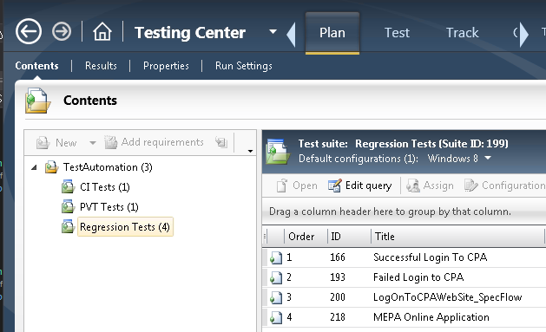
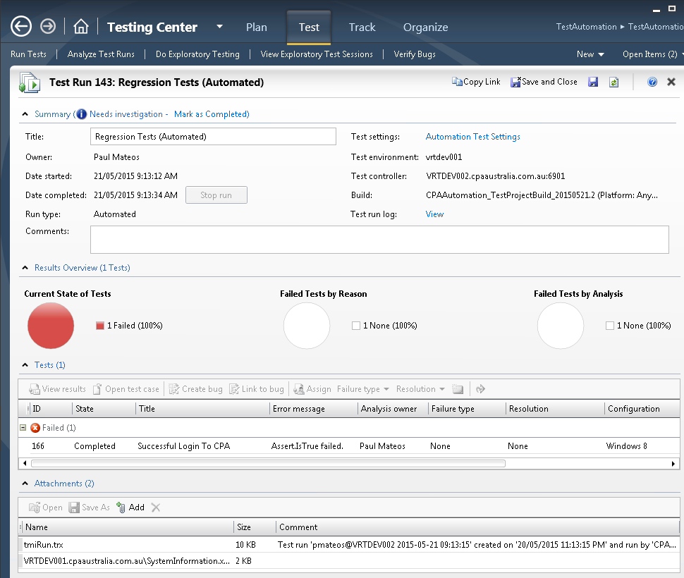
Test Manager
Where tests are managed and executed
Automated tests are seen and treated just like manual tests. This includes reporting on their test execution progress through MTM or TFS portals

Slide 6
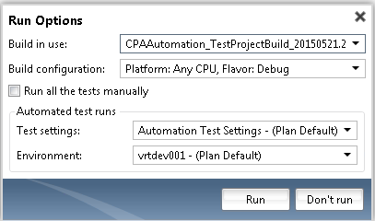
Test Manager – continue…
Run With options
The main difference is the Run Options.

Slide 7
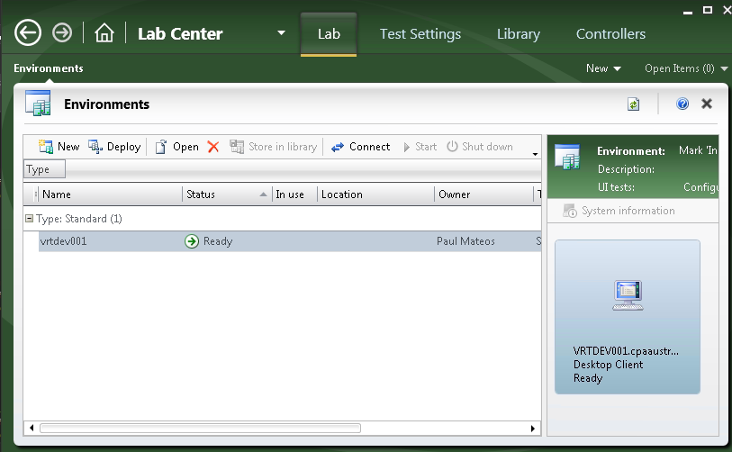
Test Manager – continue…
Lab Center
Management of the test environments is done through Lab Center.

Slide 8
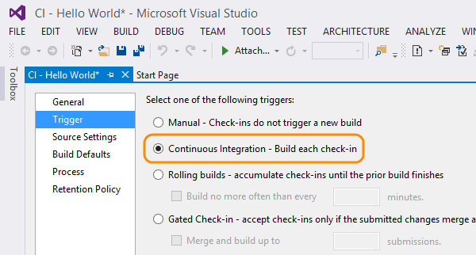
TFS ALM – Build Definitions
Different Trigger Options
They can be triggered to run by many different methods.
Build Definitions – A workflow of activities that facilitate the creation of artefacts and the use of those artefacts.

Slide 9
“I can only pay attention for another minute until this smile fades away. Hurry up and show me some automation!”

Slide 10
Demo
Running Tests from MTM
Running Tests from Build Definition
Running Tests as part of CI
Running Tests from a command line
Through Build Definitions
Through MTM
Through MSTest
Running a SpecFlow Test

Slide 11
Where To From Here?
Start Building Tests
The current solution is ready to use now!
CI can be implemented later on
Tests can be run through MTM by anyone
Utilise Planit’s resources for initial ramp-up
Team collaboration is more affective
Get the page models mapped early
Quick wins to show good ROI
Prepare for CI
Apply customisations to dev environment processes
Harden architecture and infrastructure
Small steps to minimise interruptions

Slide 12
Questions?
We Appreciate Your Participation!
Paul Mateos Technical Team Lead
pmateos@planit.net.au
Michael Pollino Technical Test Consultant
mpollino@planit.net.au

